Slide 1
CSS Advanced
By - Himank Jha

Slide 2
Properties for the Parent(Flex Container)
Display (https://www.w3schools.com/css/css3_flexbox.asp)
This defines a flex container & enables a flex context for all its direct children
.container { display: flex; /* or inline-flex */ }

Slide 3
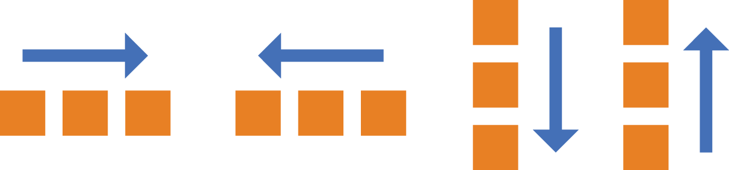
Properties for the Parent(Flex Container)
Flex-direction (https://www.w3schools.com/css/css3_flexbox.asp)
This defines the direction of flex items that are placed in the flex container
.container { flex-direction: row | row-reverse | column | column-reverse; }

Slide 4
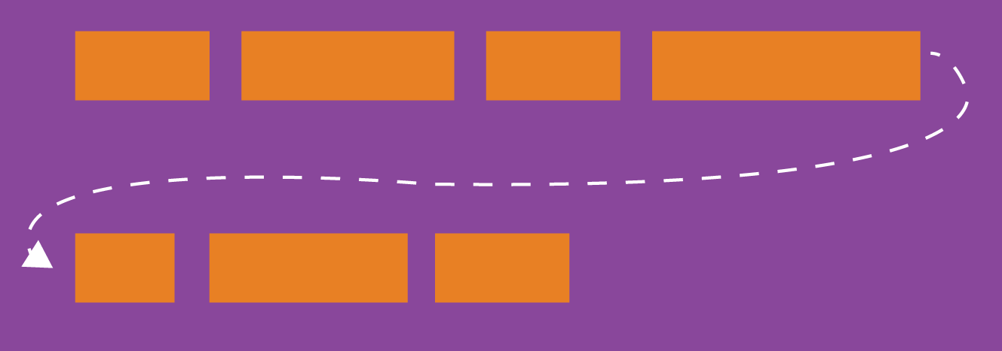
Properties for the Parent(Flex Container)
Flex-wrap (https://www.w3schools.com/css/css3_flexbox.asp)
By default, flex items will all try to fit onto one line. You can change that and allow the items to wrap as needed with this property.
.container { flex-wrap: nowrap | wrap | wrap-reverse; }

Slide 5
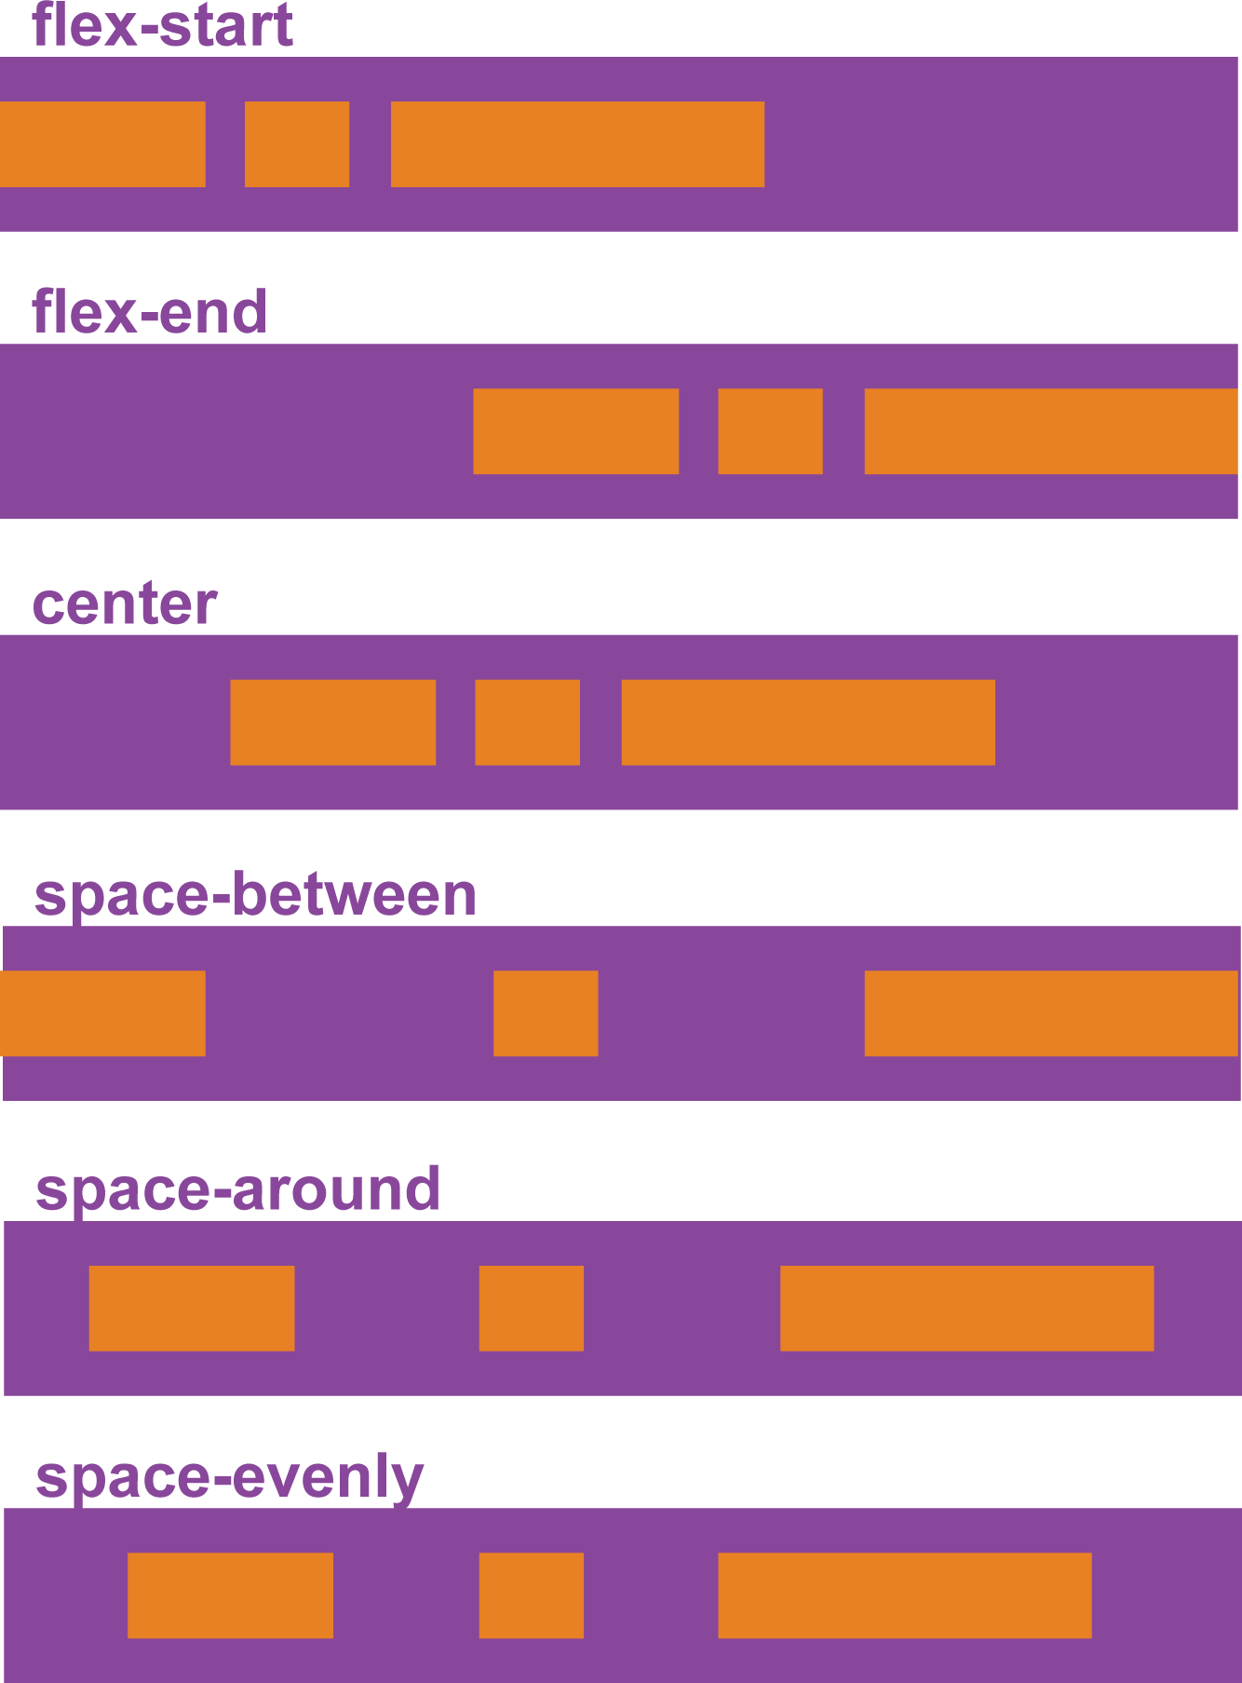
Properties for the Parent(Flex Container)
Justify-content (https://www.w3schools.com/css/css3_flexbox.asp)
The justify-content property is used to align the flex items
.container { justify-content: flex-start | flex-end | center | space-between | space-around | space-evenly; }

Slide 6
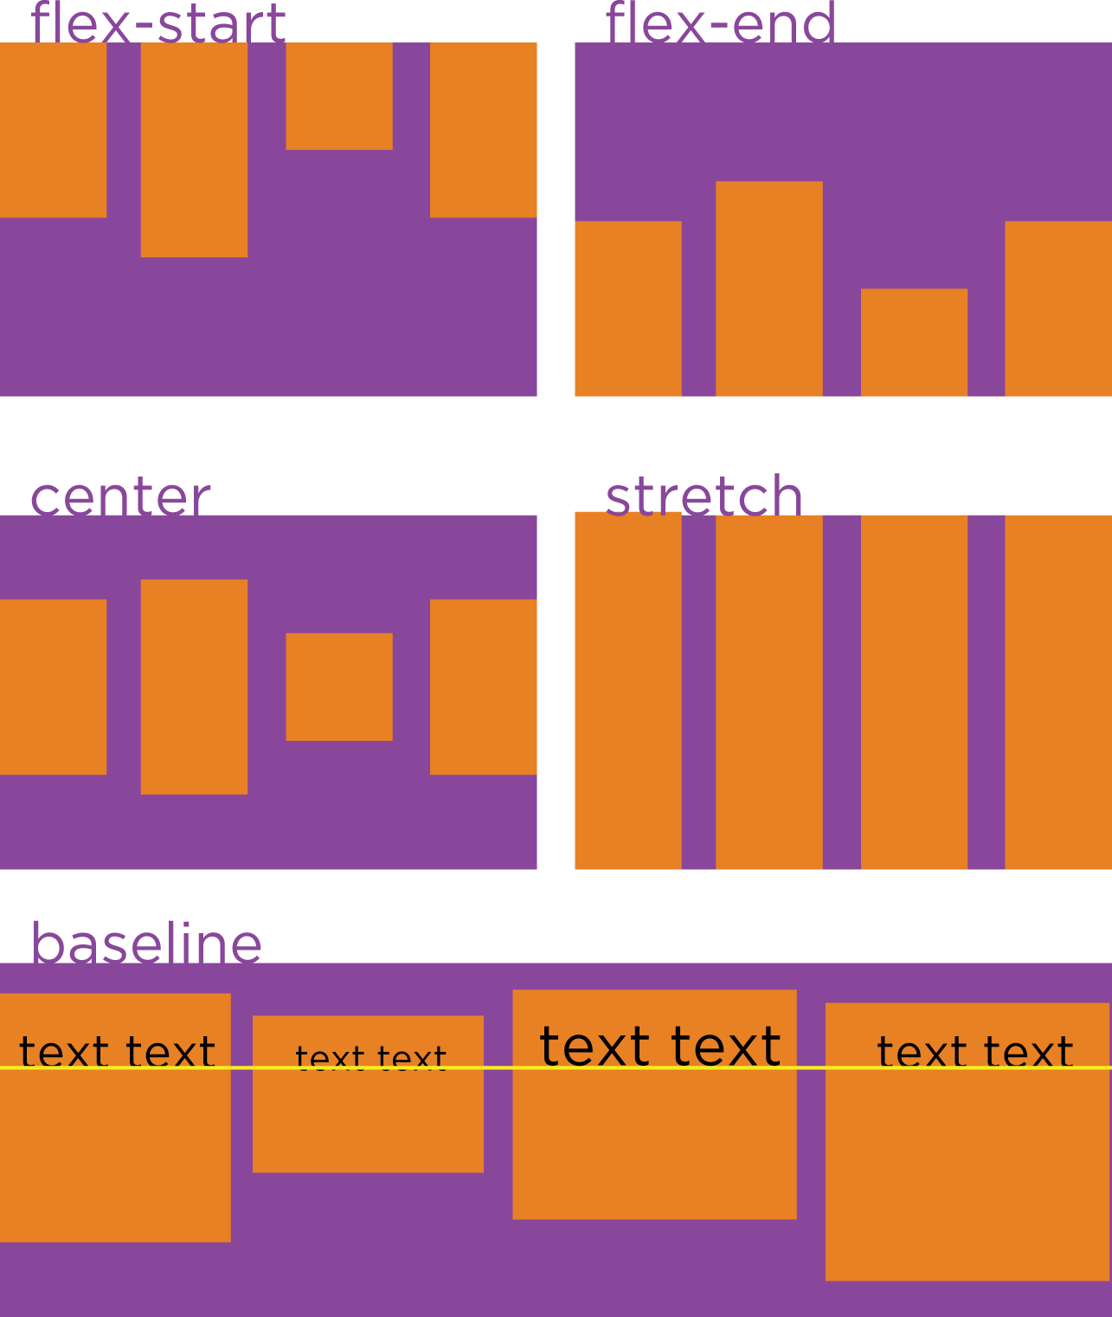
Properties for the Parent(Flex Container)
Align-items (https://www.w3schools.com/css/css3_flexbox.asp)
The align-items property is used to align the flex items vertically
.container { align-items: flex-start | flex-end | center | baseline | stretch; }

Slide 7
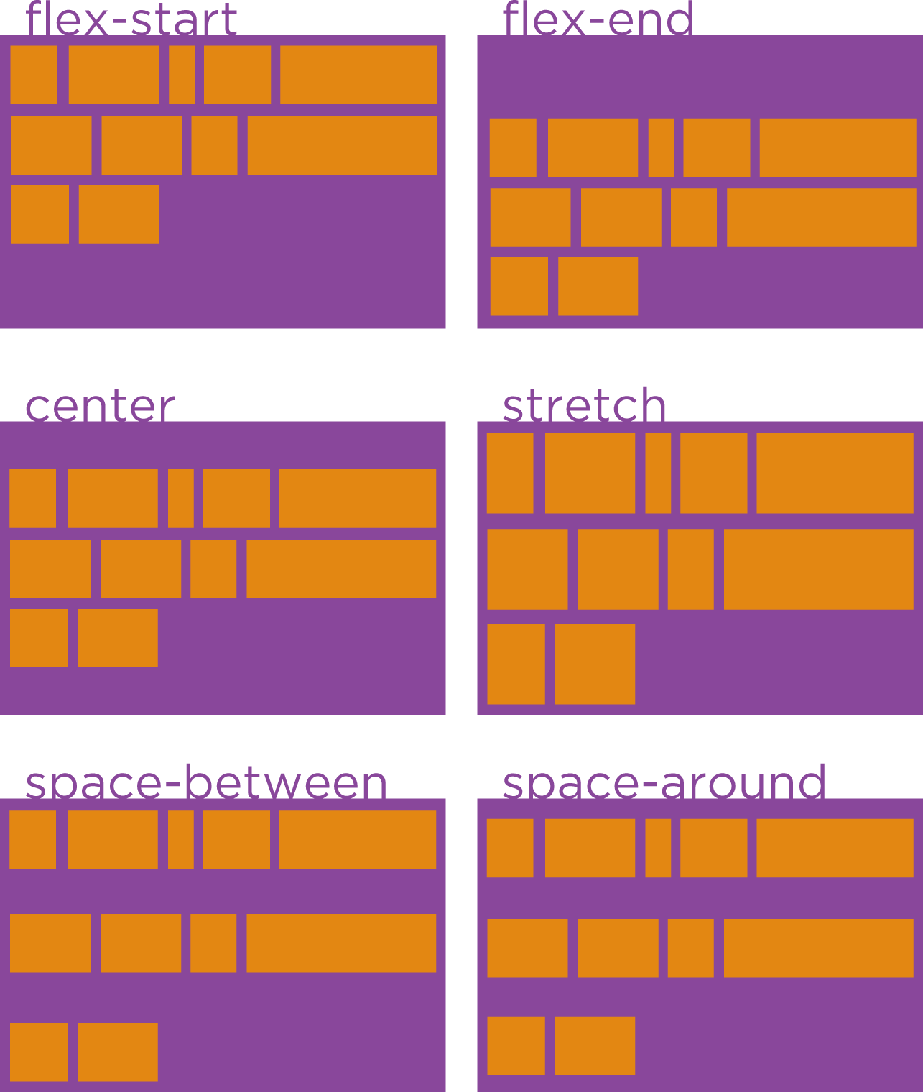
Properties for the Parent(Flex Container)
Align-content (https://www.w3schools.com/css/css3_flexbox.asp)
The align-content property is used to align the flex lines
.container { align-content: flex-start | flex-end | center | space-between | space-around | stretch; }
Notes:
session should begin with review of what was done in the last session. should ask any questions they may have regarding previous session

Slide 8
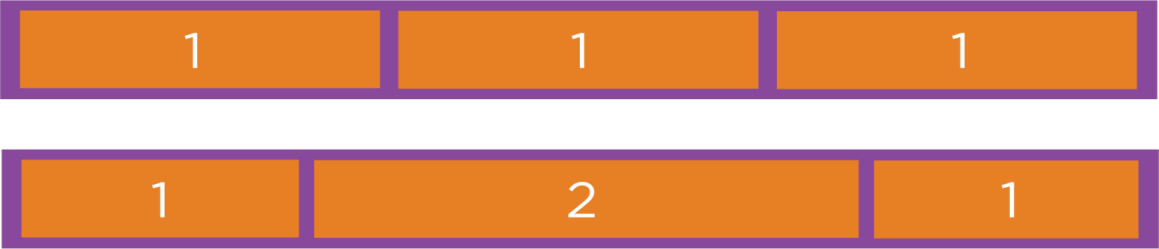
Properties for the Child(Flex Items)
Flex-grow (https://www.w3schools.com/css/css3_flexbox.asp)
This defines the ability for a flex item to grow if necessary.
.item { flex-grow: <number>; /* default 0 */ }

Slide 9
Properties for the Child(Flex Items)
Flex-shrink (https://www.w3schools.com/css/css3_flexbox.asp)
This defines the ability for a flex item to shrink if necessary. Negative numbers are invalid.
.item { flex-shrink: <number>; /* default 1 */ }

Slide 10
Properties for the Child(Flex Items)
Flex-basis (https://www.w3schools.com/css/css3_flexbox.asp)
This defines the default size of an element before the remaining space is distributed.
.item { flex-basis: <length> | auto; /* default auto */ }

Slide 11
Properties for the Child(Flex Items)
Flex (https://www.w3schools.com/css/css3_flexbox.asp)
This is the shorthand for flex-grow, flex-shrink and flex-basis combined.
.item { flex: none | [ <'flex-grow'> <'flex-shrink'>? || <'flex-basis'> ]; }

Slide 12
Properties for the Child(Flex Items)
Align-self (https://www.w3schools.com/css/css3_flexbox.asp)
This allows the default alignment (or the one specified by align-items) to be overridden for individual flex items.
.item { align-self: auto | flex-start | flex-end | center | baseline | stretch; }

Slide 13
Pseudo class selectors
:hover - When the mouse cursor rolls over a link, that link is in it's hover state and this will select it.
:active - Selects the link while it is being activated (being clicked). For example, for the "pressed" state of a button-style.
:focus - This will select links that are the current focus of the keyboard.
(https://www.w3schools.com/css/css_pseudo_classes.asp)

Slide 14
Position/Number-based pseudo class selectors
:first-child - Selects the first element within a parent.
:last-child - Selects the last element within a parent.
:nth-child() - Selects elements based on a simple provided algebraic expression (e.g. "2n" or "4n-1"). Has the ability to do things like select even/odd elements, "every third", "the first five", and things like that.
(https://www.w3schools.com/css/css_pseudo_classes.asp)

Slide 15
Position/Number-based pseudo class selectors
:nth-of-type() - Works like :nth-child, but used in places where the elements at the same level are of different types. Like if inside a div you had a number of paragraphs and a number of images. You wanted to select all the odd images. :nth-child won't work there, you'd use div img:nth-of-type(odd).
:first-of-type - Selects the first element of this type within any parent.
:last-of-type - Same as above, only would select the last image inside the first div and the last image inside the second div.
(https://www.w3schools.com/css/css_pseudo_classes.asp)

Slide 16
Content-related pseudo "elements"
::before - Is able to add content before a certain element.
::after - Is able to add content after a certain element.
(https://www.w3schools.com/css/css_pseudo_classes.asp)

Slide 17
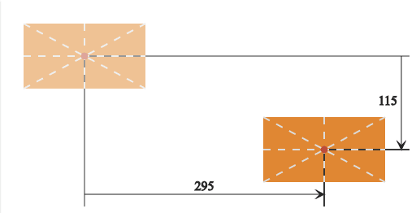
CSS3 Transforms
Translate (https://www.w3schools.com/css/css3_2dtransforms.asp)
A translation moves all the points of an element in the same direction and by the same amount.
.element { transform: translate(295px, 115px); }

Slide 18
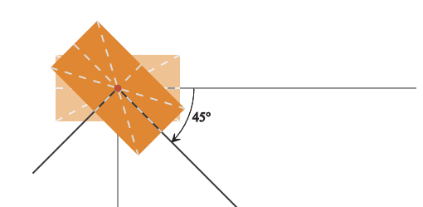
CSS3 Transforms
Rotate (https://www.w3schools.com/css/css3_2dtransforms.asp)
A 2D rotation moves an element and any descendants it may have around a fixed point.
.element { transform: rotate(45deg); }

Slide 19
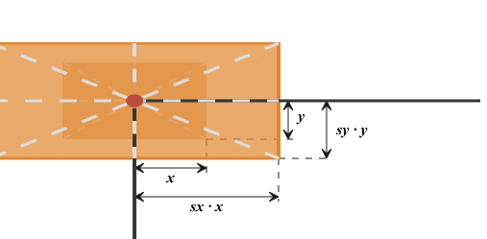
CSS3 Transforms
Scale (https://www.w3schools.com/css/css3_2dtransforms.asp)
The scale() CSS function defines a transformation that resizes an element on the 2D plane.
.element { transform: scale(2, 1.5); }

Slide 20
CSS3 Transition
Transition (https://www.w3schools.com/css/css3_2dtransforms.asp)
These transition properties allow elements to change values over a specified duration, animating the property changes, rather than having them occur immediately.
.element { transition: s[transition-property] [transition-duration] [transition-timing-function] [transition-delay]; }

Slide 21
CSS3 Transition
Transition-property (https://www.w3schools.com/css/css3_2dtransforms.asp)
The transition-property property, is used to define what property, or properties, you want to apply a transition effect to.
.element { transition-property: color; }

Slide 22
CSS3 Transition
Transition-timing-function (https://www.w3schools.com/css/css3_2dtransforms.asp)
This define a function that describes how a transition will proceed.
.element { transition-timing-function: ease-out; }
(ease, linear, ease-in, ease-out, ease-in-out, step-start, step-end)

Slide 23
CSS3 Transition
Transition-delay (https://www.w3schools.com/css/css3_2dtransforms.asp)
The transition-delay property, is used to define a length of time to delay the start of a transition.
.element { transition-delay: 5s; }

Slide 24
CSS3 media queries
Media queries are used to apply different styles for different media types/devices
@media not|only mediatype and (expressions) { CSS-Code; }
all Used for all media type devices print Used for printers screen Used for computer screens, tablets, smart-phones etc. (https://www.w3schools.com/css/css3_mediaqueries.asp)

Slide 25
Sass/Scss
Sass/Scss is a CSS pre-processor that lets you use features like variables, nesting, mixins, inheritance which reduces repetition of CSS. It is then further compiled into css using terminal command : sass --watch input.scss output.css
Using above terminal code would take single Sass file, input.scss, and compile that file to output.css. (https://sass-lang.com/guide)

Slide 26
Variables
Variables are a way to store information that you can re-use later. With Sass, you can store information in variables, like strings, numbers, colors & booleans. Sass uses the $ symbol to make something a variable
$font-stack: Helvetica, sans-serif; $primary-color: #333; body { font: 100% $font-stack; color: $primary-color; } (https://sass-lang.com/guide)

Slide 27
Nesting
nav { ul { margin: 0; } a { display: block; } }
nav ul { margin: 0; } nav a { display: block; } (https://sass-lang.com/guide)

Slide 28
Extend/Inheritance
Using @extend lets you share a set of CSS properties from one selector to another.
%message-shared { border: 1px solid #ccc; padding: 10px;}
.message { @extend %message-shared; } (https://sass-lang.com/guide)

Slide 29
THANK YOU
Himank Jha
himank.jha@metacube.com

